Slide 1
Analysis of ACT and SAT datasets

Slide 2
Problem
Dataset
Context
Task
Average SAT and ACT scores by state
2017 year
Analyze data and find out how we can benefit from them

Slide 3
Average ACT scores by state (2017)
State | Participation | English | Math | Reading | Science | Composite
Alabama | 100% | 18.9 | 18.4 | 19.7 | 19.4 | 19.2
Alaska | 65% | 18.7 | 19.8 | 20.4 | 19.9 | 19.8
Arizona | 62% | 18.6 | 19.8 | 20.1 | 19.8 | 19.7
Arkansas | 100% | 18.9 | 19.0 | 19.7 | 19.5 | 19.4
California | 31% | 22.5 | 22.7 | 23.1 | 22.2 | 22.8
Colorado | 100% | 20.1 | 20.3 | 21.2 | 20.9 | 20.8
... | ... | ... | ... | ... | ... | ...

Slide 4
Average SAT scores by state (2017)
State | Participation | Evidence-Based Reading and Writing | Math | Total
Alabama | 5% | 593 | 572 | 1165
Alaska | 38% | 547 | 533 | 1080
Arizona | 30% | 563 | 553 | 1116
Arkansas | 3% | 614 | 594 | 1208
California | 53% | 531 | 524 | 1055
Colorado | 11% | 606 | 595 | 1201
... | ... | ... | ... | ...

Slide 5
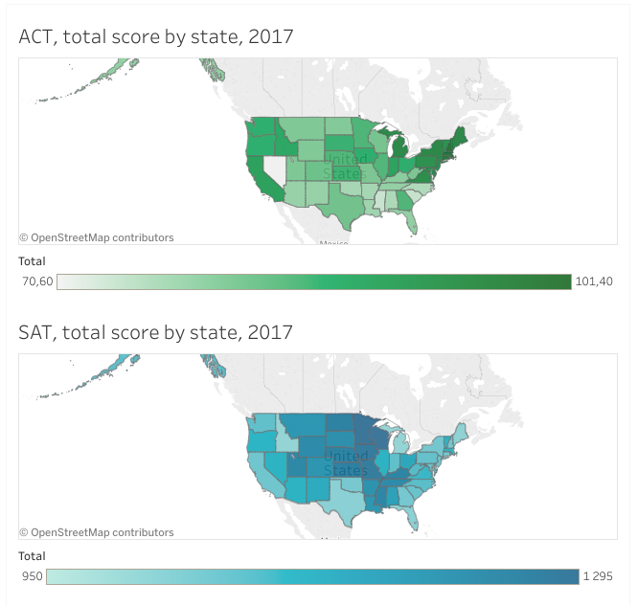
Total score of ACT and SAT by state

Slide 6
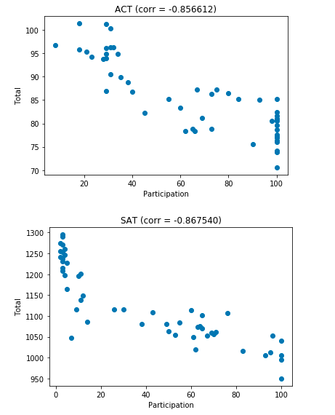
Dependence of total score on participation, ACT and SAT

Slide 7
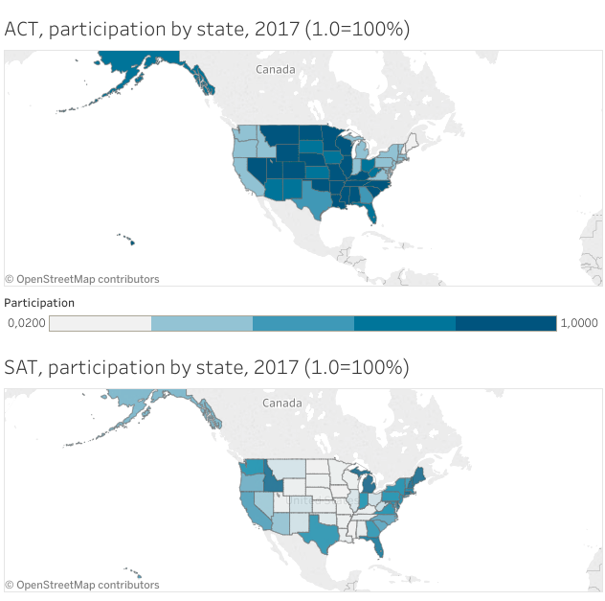
Participation of ACT and SAT by state

Slide 8
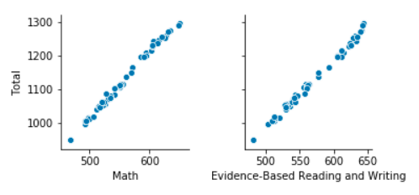
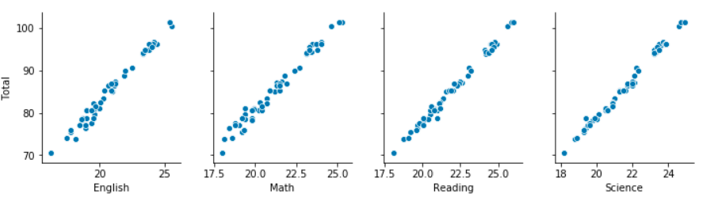
SAT
Dependences of total score on subjects, SAT and ACT
ACT

Slide 9
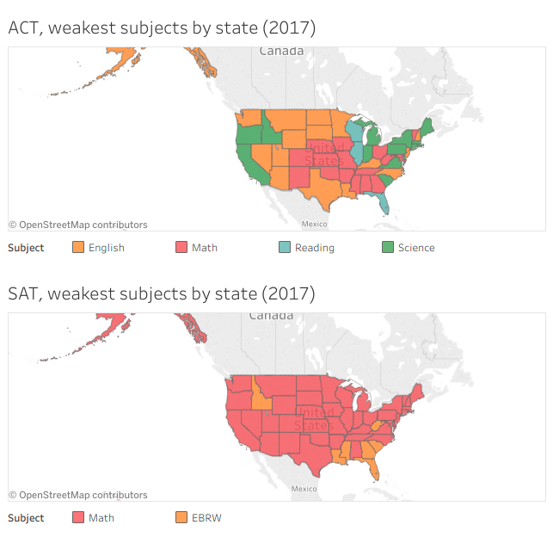
The weakest subjects by state, ACT and SAT

Slide 10
Results
There is no “weak” or “strong” states, average score depends on participation
The less students passed SAT, the more students passed ACT, and vice versa
It is possible to identify the weakest subject in each state
макс. рост

